Slide 1
Discussion 7: Asymptotics II, Search Trees
Christine Zhou

Slide 2
Announcements
Homework 2 due today, March 6!
Homework 3 will be released on Thursday morning
Due Monday, March 11
Midterm 1 Regrade Requests due by this Friday at 11:59pm!
SIgn up to meet with me if you’re interested!
Resources: tinyurl.com/cs61b-christine-zhou
Survey: tinyurl.com/cz-disc7-sp19

Slide 3
Notation: Big O, Big Omega, Big Theta
Goal: Look at program complexity for large input
Notations:
Big O - upper bound
Big Omega - lower bound
Big Theta - upper and lower bound
Notes:
Introduce the 3 common ways of assessing runtime. We’ll go in more detail on the next couple slides.
It’s important here that students know to represent runtime as algebraic inputs like 6n^2 + 9 for example.

Slide 4


O (Big O)
Let f(n) and g(n) be positive real numbers on inputs of size n
f ∈ O(g) if there is a constant c > 0 s.t. f(n) <= c g(n)
Upper bounded by g(n) when n gets significantly large.
Bound does not have to be tight.
True or false?
N² ∈ O(N²)
N² ∈ O(N⁵⁰⁰)
N log N ∈ O(N)
log N ∈ O(N²)
Notes:
Make sure students understand that big O is a worst case analysis of the program and is an upper bound on the runtime. Bound doesn’t have to be tight, meaning O(2^n) for an n^2 problem but generally, expect the tightest big O bound.

Slide 5
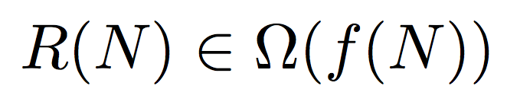
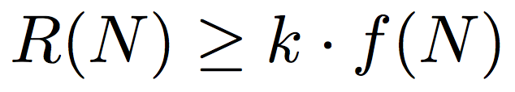
Ω (Big Omega)
Let f(n) and g(n) be positive real numbers on inputs of size n
f ∈ Ω(g) if there is a constant c > 0 s.t. f(n) >= c g(n)
Lower bounded by g(n) when n gets significantly large.
Bound does not have to be tight.
True or false?
N² ∈ Ω(N²)
N ∈ Ω(1)
N² ∈ Ω(N³)
Notes:
Same idea, but with big omega

Slide 6


Θ (Big Theta)
Let f(n) and g(n) be positive real numbers on inputs of size n
f ∈ Θ(g) if there is a constant c1 > 0 and c2 > 0 s.t.
C1 g(n) <= f(n) <= c2 g(n) for all c1 <= c2
Tightly bounded by g(n) when n gets significantly large.
• f ∈ Ω(g) and f ∈ O(g)
Notes:
The important point here is big theta is just squeezing the runtime between big O and big Omega. It’s a tight bound so best and worst case. Always case.

Slide 7
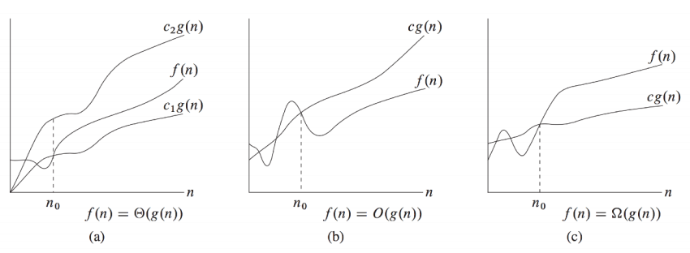
Introduction to Algorithms, Cormen, Leiserson, Rivest, Stein
Notes:
Good visual example. Important to note that for small inputs, bounds could be wrong but as n -> infinity, we see how the bounds.

Slide 8
Conventions: No Constants
Drop multiplicative constants and lower order terms
If our runtime is actually 2N^2 + N, we say the runtime is Theta(N^2)
Any exponential dominates any polynomial
Any polynomial dominates any logarithm

Slide 9
Common Asymptotic Sets
O(1): constant
O(log n): logarithmic
O(sqrt(n)): square root
O(n): linear
O(n log n): linearithmic
O(n^2): quadratic
O(n^3): cubic
O(2^n): exponential
O(n!): factorial
Notes:
Good recap after the first problem.

Slide 10
Techniques for Analyzing Runtime
Annotate your code
Write down runtimes of called functions
Consider end conditions for loops and consequently the number of times we could run the loop
What are the terminating conditions for a loop?
Can we algebraically express the runtime of the loop?
Branching factor
Do we make additional calls and if so, how many subproblems do we make?

Slide 11
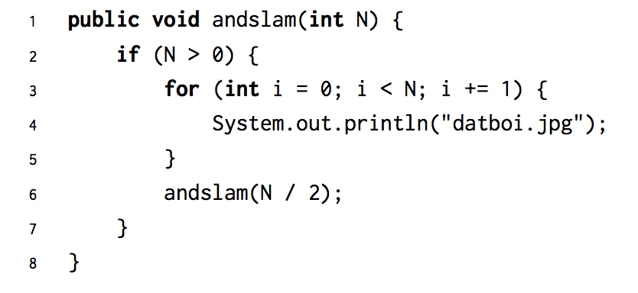
Problem 1.1

Slide 12
Problem 1.1
Best: Θ(N)
Worst: Θ(N)

Slide 13
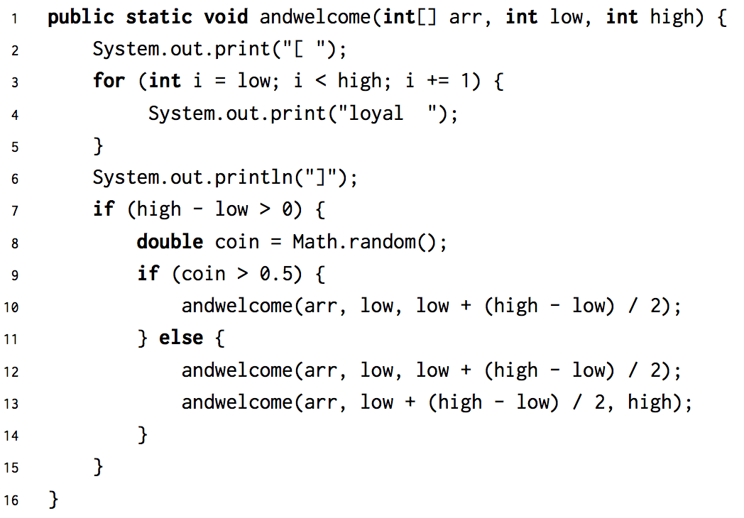
Problem 1.2

Slide 14
Problem 1.2
Worst case: Θ(N log N)
Best case: Θ(N)
Alternatively: Omega(N) and O(N log N)

Slide 15
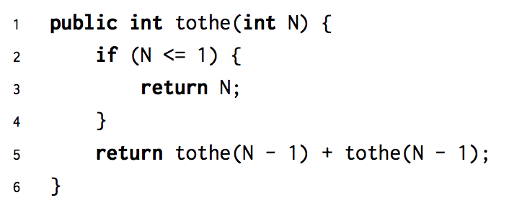
Problem 1.3

Slide 16
Problem 1.3
Best: Θ(2^N)
Worst: Θ(2^N)
2^i nodes per layer and each node does O(1) work

Slide 17
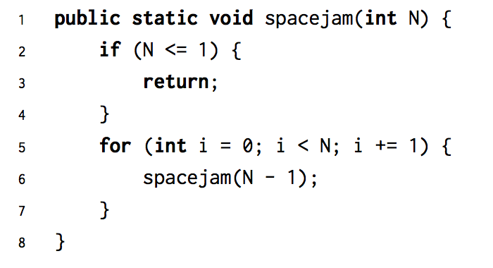
Problem 1.4

Slide 18
Binary Search Tree
Every key in the left subtree is less than X’s key
Every key in the right subtree is greater than X’s key
dog
bag
flat
alf
cat
elf
glut
Binary Search Tree

Slide 19
BST Runtimes
Shape of Tree | Height | add | search
“Bushy” | logN | Θ(logN) | Θ(logN)
“Spindly” | N | Best: Θ(1) Worst: Θ(N) | Best: Θ(1) Worst: Θ(N)
Notes:
I think the search runtimes need to be best case/worst case for each tree (i.e, for a bushy tree, search is theta(log N) in the worst case)

Slide 20
2) Is This a BST?
The following method isBSTBad is supposed to check if a given binary tree is a BST, though for some binary trees, it is returning the wrong answer. Think about an example of a binary tree for which isBSTBad fails.
Let’s do this one together!

Slide 21
2) Is This a BST?
According to `buggyIsBST`, what are the key conditions to be checked?
value at a node is greater than its left child
value at a node is less than its right child
Are just these conditions sufficient?
dog
bag
flat
alf
cat
elf
glut

Slide 22
2) Is This a BST?
According to `buggyIsBST`, what are the key conditions to be checked?
value at a node is greater than its left child
value at a node is less than its right child
Are just these conditions sufficient?
What if?
dog
bag
flat
alf
zebra
elf
glut
Notes:
Zebra is in the right place with respect to Bag, but in the wrong place with respect to Dog
Therefore, Correct Condition:
Every node value is greater than every node in the left subtree and less than every node
in the right subtree.

Slide 23
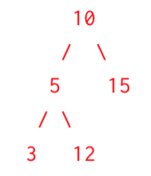
2) Is This a BST?
Think about an example of a binary tree for which buggyIsBST fails.

Slide 24
2) Is This a BST?
Then, write isBSTGood so that it returns the correct answer for any binary tree. The TreeNode class is defined as follows:
class TreeNode {
Int val;
TreeNode left, right;
}
Hint: You will find Integer.MIN_VALUE and Integer.MAX_VALUE helpful with isBSTGood!

Slide 25
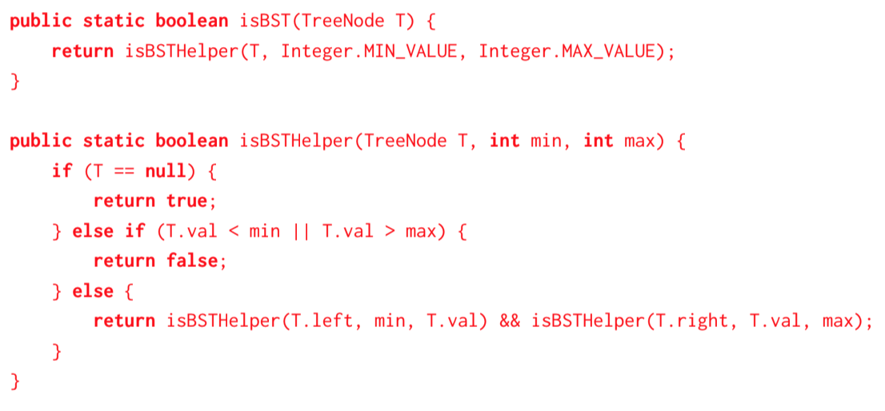
2) Is This a BST?

Slide 26
BST Runtimes
Let’s go back to these runtimes...
Shape of Tree | Height | add | search
“Bushy” | logN | Θ(logN) | Θ(logN)
“Spindly” | N | Best: Θ(1) Worst: Θ(N) | Best: Θ(1) Worst: Θ(N)
Notes:
I think the search runtimes need to be best case/worst case for each tree (i.e, for a bushy tree, search is theta(log N) in the worst case)

Slide 27
Balanced Search Trees
m q
e
o
s u
b
g
n
p
r
t
v
Bushy was better than spindly trees in terms of runtime
2-3 Trees!
Should still follow the BST property (less on the left, greater on the right)
Each node contains 1-2 elements with 2-3 children nodes
Maintains log(N) height of “bushy” BST’s!
If we want to insert an element, we’ll traverse and put it in the corresponding leaf node
It’s possible that it will have more than 2 elements
Split the node, and send up middle element, this can happen recursively

Slide 28
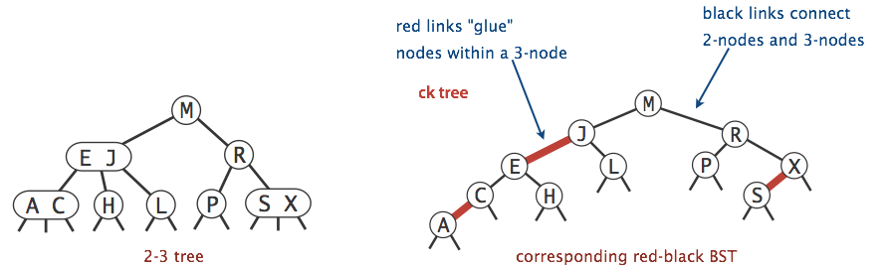
Left-Leaning Red-Black Trees
How do we implement 2-3 trees in code?
A binary tree that colors links red and black
Any red links are “glue”, meaning the two nodes are in the same 2-3 tree node
Notes:
Not covered yet!

